Slide 1

LOST And found website
By Naman Bhagat (21BCS140), Nikhil Gupta(21BCS147), Navneet Raj(21BCS143)

Slide 2
Introduction
During the course of this project, we plan on making a completely functioning website to make it easy to find anyone’s lost belongings. WE plan on trying to make it as intuitive yet sophisticated as possible for the users of the website. This is extremely practical and reliable for everyone as we race against time everyday and happen to lose our things often. Taking inspiration from our college itself, we decided to make a platform where issues of losing stuff becomes easy to sort out. Also, this will help us hone our skills about managing and working with databases and DBMS, which is a very fruitful skill for someone in the IT industry to have. Hopefully, we will be able to make a working website and more so a good one.

Slide 3
Purpose and Scope
On a daily basis we receive a flood of lost and found mails, making it hard to spot the important e-mails. As a student or an employee out in the corporate world as well, missing important mails can be disastrous for one’s careers.
Moreover, if someone wants to find a mail from a while back it is extremely tedious to scroll all the way up, where one can easily miss the mail as well. Therefore, we need something to keep all this well organized.
To solve this problem, we are trying to make a full functioning website that can help keep the lost and found organized.

Slide 4
Overall Description
System features and requirements
Functional requirements
Non-functional requirements
v
v

Slide 5
Technology used
Languages and technology used:
HTML
CSS
Javascript
Django
Lucidchart(for er diagram)

Slide 6
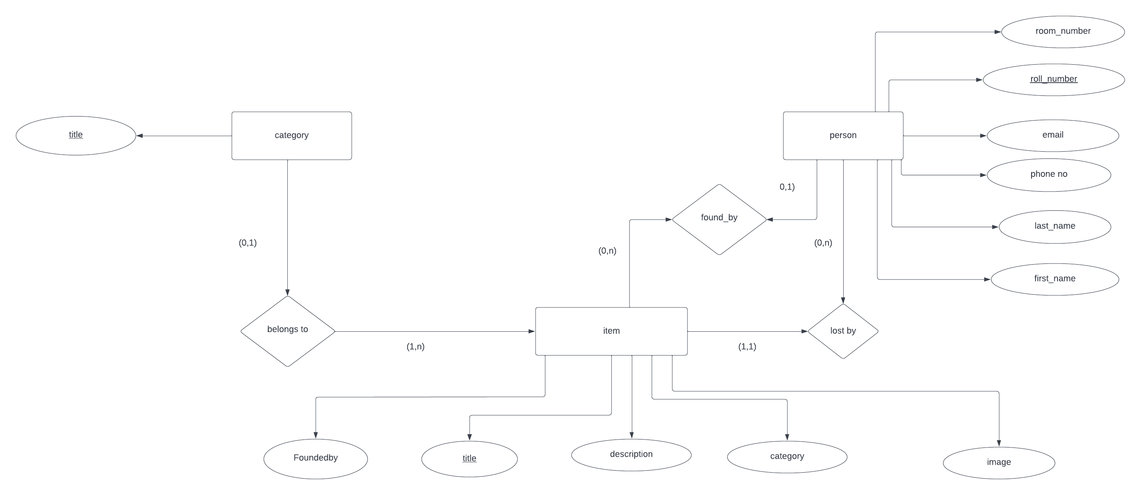
ER diagram

Slide 7
Database Designing

